Slide 1

IE2022-Introduction to Cyber Security Individual Assignment Blockchain Technology
H.P.D.D.M Wickramasinghe
IT21825682

Slide 2
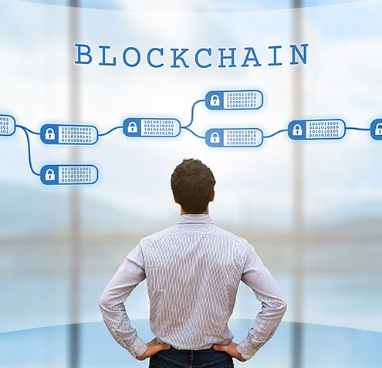
What is Blockchain?
Blockchain is a revolutionary concept that can transform industries, redefine transactions, and establish trust in the digital age. Its decentralized and transparent nature has captured worldwide attention. It's a secure ledger for multi-participant transaction verification.

Slide 3
How does blockchain technology works ?
Blockchain technology functions through complex principles and mechanisms to allow for decentralization, security, and transparency. To comprehend its workings, it's crucial to explore its key components and procedures.

Slide 4
Evolution of Blockchain Technology
History of Blockchain
The story of blockchain is about new ideas, big advancements in technology, and finding ways to share power. The idea of blockchain is new, but it started from older ideas about keeping things secret and spreading information out.
The blockchain technology was described in 1991 by the research scientist Stuart Haber and W. Scott Stornetta. They wanted to introduce a computationally practical solution for time-stamping digital documents so that they could not be backdated or tampered. They develop a system using the concept of cryptographically secured chain of blocks to store the time-stamped documents. [1]

Slide 5
What is Bitcoin?
A bitcoin is a type of digital assets which can be bought, sold, and transfer between the two parties securely over the internet. Bitcoin can be used to store values much like fine gold, silver, and some other type of investments. We can also use bitcoin to buy products and services as well as make payments and exchange values electronically. [2]

Slide 6
Types of Blockchain
Public Blockchains
Private Blockchains
Consortium Blockchains

Slide 7
Applications of Blockchain Technology
Finance
Healthcare
Supply Chain Management
Government
Education

Slide 8
Security of Blockchain Technology
Blockchain technology enhances security for digital transactions and data with its decentralized and immutable nature. "Decentralized nodes validate and record transactions for secure blockchain technology." Blockchain distributes data across multiple nodes, making it almost impossible to manipulate. Each node has a copy of the blockchain, making tampering difficult because an attacker would need to control the majority of nodes simultaneously.

Slide 9
Challenges and Limitations faced by Blockchain Technology
Complexity of Blockchain
High Energy Consumption
Scalability

Slide 10
Future Developments of Blockchain Technology
IOT (Internet of Things)
Privacy
Tokenization
DeFi

Slide 11
Conclusion

Slide 12
References
[1] Java T point," [Online]. Available: https://www.javatpoint.com/history-ofblockchain#:~:text=The%20blockchain%20technology%20was%20described,not%20b e%20backdated%20or%20tampered.
[2] "Java T Point," [Online]. Available: https://www.javatpoint.com/bitcoin.

